Slide 1
European Care Certificate
(ECC)
Train the Trainer Course
“Doing Things Right in Social Care”

Slide 2
The European Care Certificate (ECC) was developed as a basic entry certificate in the care sector through an initial Leonardo Da Vinci project from the European Commission ending in 2008.

Slide 3
The European Care Certificate is
awarded after passing an exam. It was expanded to include more member states by a second LEONARDO project which ended in September 2011 and a third project in 2012-2014 delivering training materials & online exams.

Slide 4
We completed our third LEONARDO project (2012-2014) - Not Patients but Citizens With Rights – which produced an ECC training programme for workers and a course to 'train the trainers' to deliver this new training based on the principles of the UN Convention on the Rights of People With Disabilities

Slide 5
The ECC provides employers with evidence that the holder of the Certificate has demonstrated that s/he understands the basic knowledge required to work safely in the care sector. The Learning Outcomes can be delivered through work-based training, or through a single short course or as part of a larger and/or longer course.

Slide 6
How can ECC help an employer
Recruitment and retention of staff
Improving the quality of the work of staff

Slide 7
BESCLO
The Learning Outcomes were developed by the 8 organisations working together from 6 different European Countries. These are called Basic European Social Care Learning Outcomes (BESCLO). Which are divided into 8 key areas.

Slide 8
There are no requirements about how you gain the knowledge of the Learning Outcomes - to get the Certificate you just have to show that you have the required knowledge and can apply it to situations you are likely to meet in care work.

Slide 9
BESCLO
The values of social care
Promote life quality for individuals you support
Working with risk
Understand your role as a worker
Safety at work
Communicating positively
Recognise and respond to abuse and neglect
Develop as a worker

Slide 10
How to use the ECC training pack
Lesson plans
Trainer’s Guidance
Handouts
Slides/PowerPoint presentation
Activities/exercises

Slide 11
How to get the best from your learners
Ask learners to work in pairs with the person next to them.
Go around the room giving each person in turn a number, which becomes their group number.
Ask learners to find a specified number of people that they don’t know.
Ask learners to make notes on their own.
Give learners a specified time to go and seek views from others inside or outside of the service that they work in.

Slide 12
Some different ways in which feedback can be taken are:
Groups write and / or draw pictures to summarise their discussion on large poster size paper with is pinned to the wall. The group then answers question about what they have written or drawn.
Groups or individuals write each idea on a Post It or slip of paper, which can then be stuck onto larger paper on the wall or floor. This method also enables ideas to be moved around and grouped together easily.
Individuals can move physically to different parts of the room or on a line continuum to show their support for an idea or proposal.

Slide 13
Besclo 1. The values of social care
Understand the need to promote the following values at all times:
Individuality,
Rights,
Choice,
Privacy,
Independence,
Dignity,
Respect,
Partnership

Slide 14
Besclo 1. The values of social care
Understand the need to promote equal opportunities for the individual(s) you are supporting.
Understand the need to support and respect diversity and different cultures and values.

Slide 15
UN Convention 8 Guiding principles
Respect for inherent dignity, individual autonomy including the freedom to make one's own choices, and independence of persons
Non-discrimination
Full and effective participation and inclusion in society
Respect for difference and acceptance of persons with disabilities as part of human diversity and humanity
Equality of opportunity
Accessibility
Equality between men and women
Respect for the evolving capacities of children with disabilities and respect for the right of children with disabilities to preserve their identities

Slide 16
Besclo 1. The values of social care
Prejudice
Leads to
Discrimination
leads to
Oppression

Slide 17
Besclo 1.
The values of social care
Understand the importance of confidentiality
Understand the limits of confidentiality

Slide 18
Besclo 2
Promote life quality for the individuals you support.
Understand the importance of finding out the history, preferences, wishes, needs and abilities of the individuals you are supporting.
Understand the need to make sure that everything you do is based around the individuals you are supporting.
Understand the need to enable the individuals you support to control their own lives and make informed choices about the services they receive

Slide 19
Educational needs
Employment
Health needs
History
Abilities
Needs
background
Wishes
Preferences

Slide 20
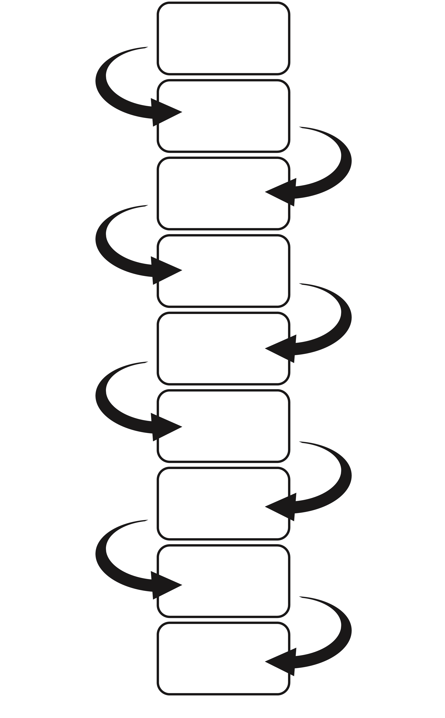
Not having any choices
Poor self image
Low self esteem
Lack in confidence
Unable to make choices
Poorer self –image
Lower self esteem
No confidence
Cannot make any choices takes a passive role
Disempowered

Slide 21
Duty of Care
You have a duty to ensure that the individual you are supporting does not put themselves in danger, others in danger or you in danger.

Slide 22
Risk Assessment
When you do a risk assessment you look at all of the hazards (all of the things that may cause harm), then you work out how bad they are and then look at ways of making them not as bad.
Degree of harm Precautions to be taken

Slide 23
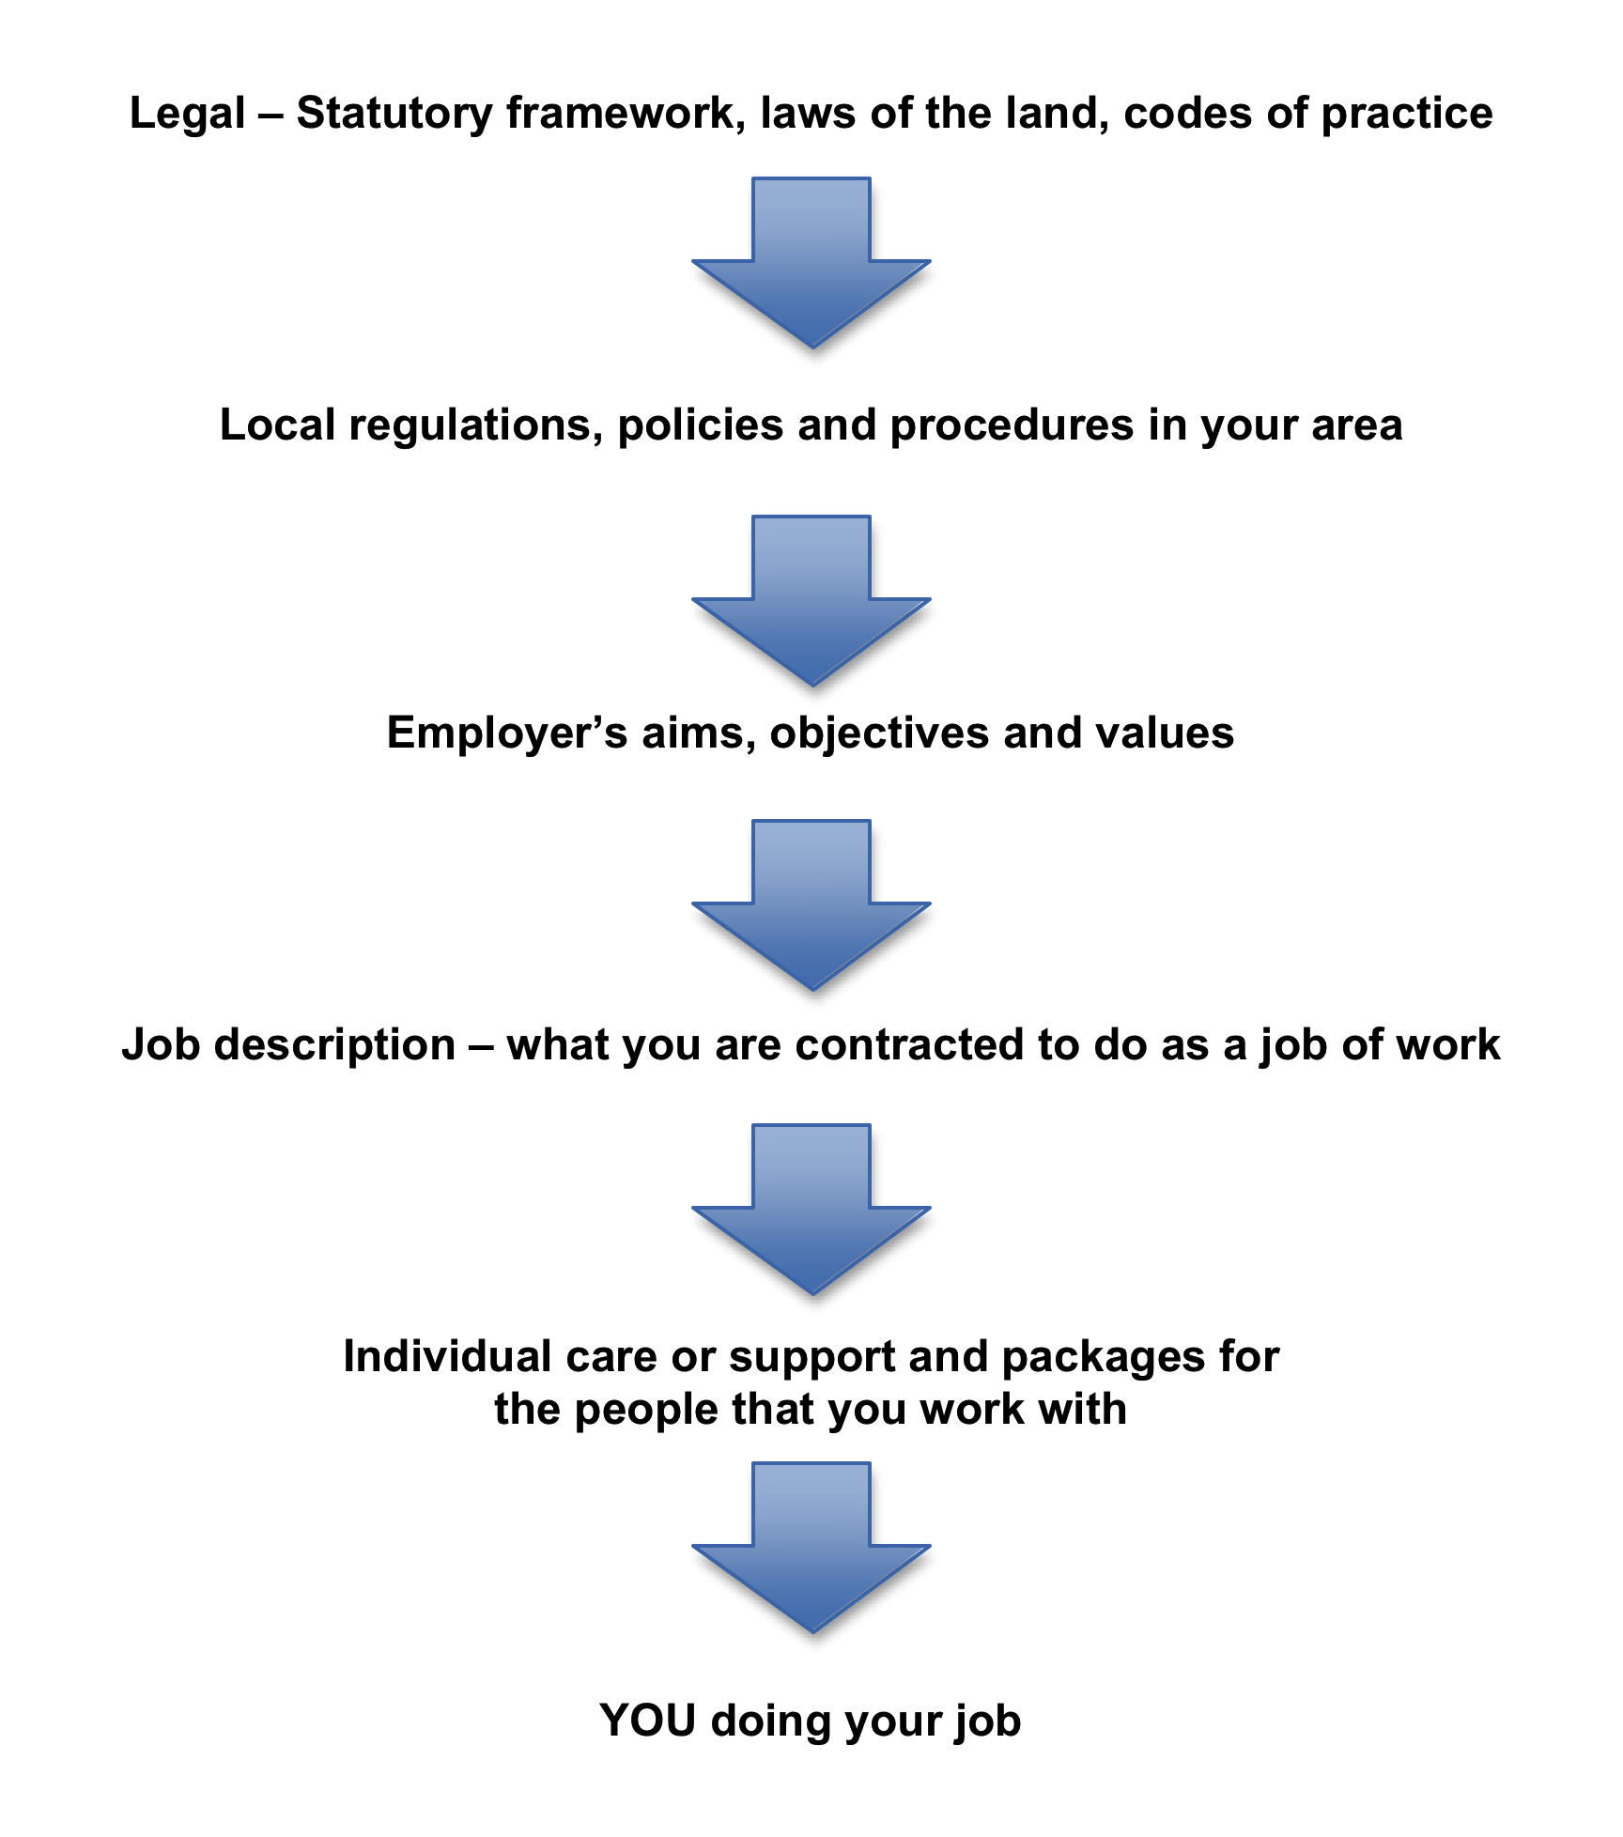

Slide 24
Working in partnership
When working with fellow professionals you must:
Observe professional boundaries (do not try to do someone else’s job!)
Share information on a ‘need to know’ basis
Do not let how you feel about the professional affect your relationship with them
Don’t collude to exclude the individual/s you are supporting

Slide 25
Working with individuals
You must not accept expensive gifts
You must not accept personal help or support from individuals using your service
You should not pass on information to others (except if the individual were at risk of harm or danger, remember confidentiality!)
You must not have sexual relationship with an individual using the service
You should never ask the individual to undertake any part of your job e.g. helping support another individual

Slide 26
Basic First Aid
What to do if an individual is unconscious?
What to do if someone is not breathing?
How to contact the emergency services?
How you can put someone into the recovery position
What to do if an individual is bleeding?
What to do if an individual is choking?
What to do if an individual has a seizure?

Slide 27
Security
This could include measures or devices such as:
Having burglar alarm
Window locks
Secondary locks on doors or windows
Separate reception area with secure door (enabling identity checks)
Door chain
Secure code entry or camera to building
Security lighting
Ways of working for checking Identity of visitors
Clear procedures for securing building at night, when leaving and when in the building

Slide 28
Personal safety and wellbeing
This could be because:
They are a lone worker
They have to handle valuables (visiting the bank depositing or collecting money)
They could have an accident or injury
They may be at risk of infection
They are working with individuals who may have challenging behaviour
They are using equipment to support individuals e.g. hoist, wheelchair etc

Slide 29
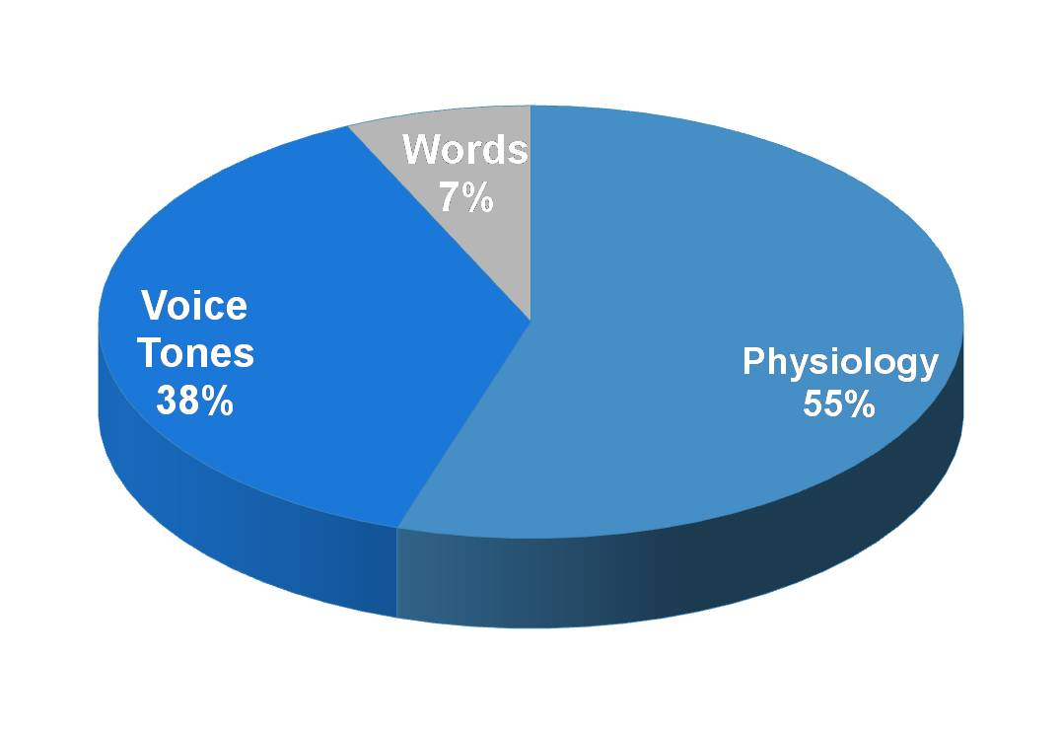
Verbal and non-verbal communication

Slide 30
Touch as a form of communication
There are some forms of touch that are not acceptable
Sexual touching of any sort is not appropriate for a worker, and will leave your managers no alternative but to instigate disciplinary procedures
Some types of touch are not acceptable in some cultures
Touching that is in any way negative
Some individuals are sensitive to touch

Slide 31
Touch as a form of communication
Whether the individual feels comfortable with touch
Whether there are any cultural taboos or customs relating to touch
What kinds of touch they would find appropriate and acceptable
How you could regularly check out that the touch you and others were using was positive and not negative.

Slide 32
What is abuse?
Definition of abuse:
‘Abuse is violation of an individual’s human and civil rights by any other person or persons’

Slide 33
Types of abuse
Physical
Sexual
Emotional and psychological
Financial
Institutional
Neglect
Medication abuse
Discrimination abuse

Slide 34
Where does abuse happen?
ANYWHERE!

Slide 35
What leads people to abuse?
Unsuitability for the work
Behavior learnt from others
Their own experience as a victim of abuse
Opportunity to exert power over another person
Entrenched or outdated views
Isolation
Insecurity
Lack of training
Lack of supervision or inappropriate supervision

Slide 36
What leads people to abuse?
Poor pay , terms of conditions of employment
Lack of clear policies and procedures
Mismatch with staff skills and demands of the job and staffing levels.
Ignorance
Lack of staff
Absence of team work
Burn out –through exhaustion form workload
Needs of individuals exceeding abilities of worker
Institutional or authoritarian regime

Slide 37
What should you do?
The worst thing you can do is nothing!
If you do nothing – you are being complicit so saying this is ok!

Slide 38
What should you do?
As a member of staff it is your responsibility to:
Act on any suspicions or disclosures of abuse/neglect
Treat all abuse or potential abuse/neglect seriously
Know the ways of working relating to abuse /neglect
Know what to do if you have a concern or have received a report
Know where to go to get help

Slide 39
What should you do”
Tell your line manager or designated person
Do not investigate , it is not your role
Do not ignore or dismiss the suspicion
Do not be judgmental
Do not discuss with colleagues or friends and family, it must be kept confidential
Do not discuss with the alleged abuser
Think about the immediate protection of the victim
Protect any evidence
Record the time and date and place, what you have been told etc.
Remember confidentiality at all times

Slide 40
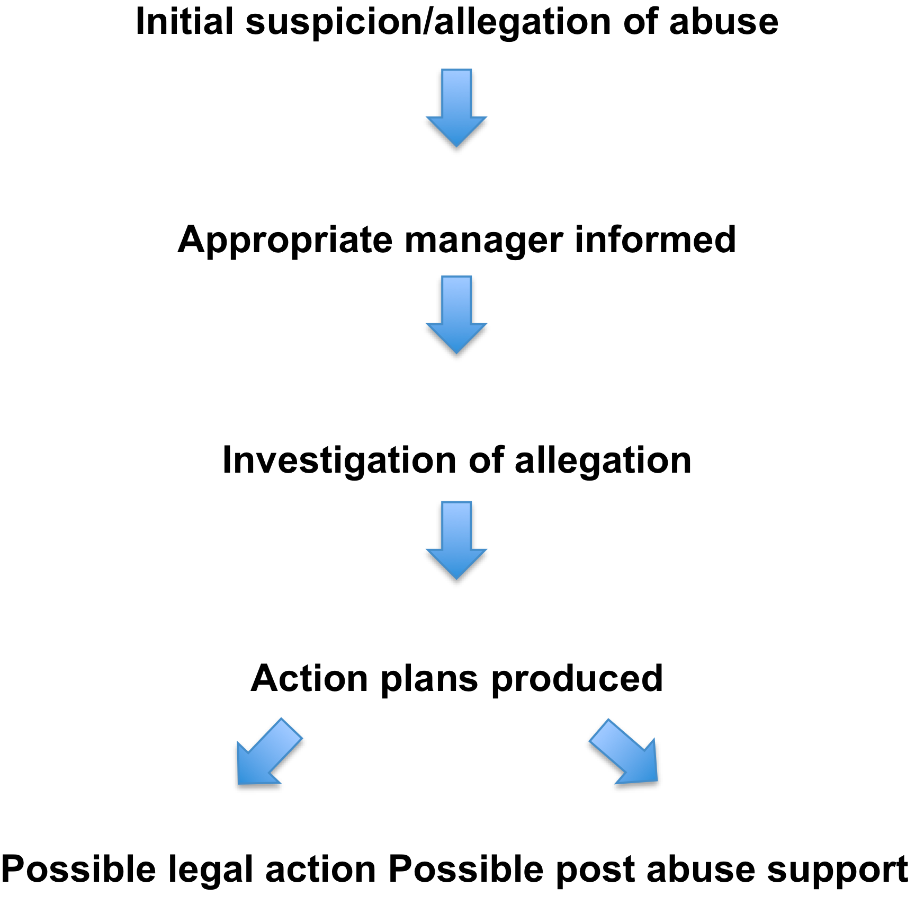

Slide 41
Supervision
Such sessions offer:
A chance to share any problem areas of work
The opportunity to benefit from other’s experience and expertise
Time to give you feedback on your practice
To share successes you have had the expertise you are developing
The opportunity to plan your work and to identify any areas where you may be overloaded or under utilsed
The opportunity to discuss areas of training need or for personal development

