Slide 1


European Care Certificate
Training Course
This project has been funded with support from the European Commission. This publication [communication] reflects the views only of the author, and the Commission cannot be held responsible for any use which may be made of the information contained therein

Slide 2
European Care Certificate
(ECC)
This is the minimum level of induction that all care workers should complete when starting to work in health and social care.
It comprises of the Basic European Social Care Learning Outcomes (BESCLO)

Slide 3
The BESCLO are listed below:
The values of social care
Promote life quality for the individuals you support
Working with risk
Understand your role as a support worker
Safety at work
Communicating positively
Recognise and respond to abuse and neglect
Develop as a worker

Slide 4
The main values that support working in social care are:
Rights
This is ensuring an individual’s rights are upheld at all times, especially when an individual may not be in a position to ensure themselves that their rights are being upheld. This includes the rights of people to be treated equally and to be valued as individuals.

Slide 5
The main values that support working in social care are:
Individuality
This is about ensuring you treat each person as an individual and not as if they are the same as everyone in a group. Encourage an individual to be himself or herself, to develop a sense of identity which is special and unique.

Slide 6
The main values that support working in social care are:
Choice
This is about choice in basic things such as what we wear and what we eat for breakfast, along with larger issues such as where we live and how we choose to live our lives. You need to ensure that the individuals who you work with also understand the consequences of the choices they make. This means they are making ‘informed’ choices.

Slide 7
The main values that support working in social care are:
Privacy
This is linked closely to respect and dignity. It is about having time and space on your own, if you want it. You should ensure privacy is maintained when you are working with an individual on such things as their personal care or finances.

Slide 8
The main values that support working in social care are:
Independence
When you are working in the care sector the temptation is to want to ‘look after’ an individual, which may result in stifling his or her independence. Your role is to empower the individual to develop and maintain their independence as much as possible

Slide 9
The main values that support working in social care are:
Dignity
This is related to an individual’s self esteem, giving them a degree of worth or honour. This is achieved through personal development and personal expression. Dignity is promoted in how we speak to people and the way we do things with others.

Slide 10
The main values that support working in social care are:
Respect
This is linked to dignity and is about showing regard and courtesy for others. Ensuring that what an individual says and does is important and matters.
Partnership
This is about working together to achieve aims and goals. Working together with the individuals you support, their family, friends and carers, colleagues and other professionals.

Slide 11
The main values that support working in social care are:
Empowerment
This is about enabling the person to do things for themselves, giving them a sense of confidence and competence.
Inclusion
This is about ensuring the individual you support is included in activities, making choices and making decisions in all aspects of their life

Slide 12
The main values that support working in social care are:
Self determination
Self-determination means being who you want to be and making the choices that make this possible. It is important to encourage individuals to have self-determination, so that they can make choices and decisions about their life.

Slide 13
Guidance and Laws Supporting these values:
Mental Capacity Act 2005
Human Rights Act 1998
Civil Partnerships Act 2004
Equalities Act 2010

Slide 14
UN Convention on the Rights of People with Disabilities
The purpose of the UN Convention is:
To promote, protect and ensure the full and equal enjoyment of all human rights and fundamental freedoms by all persons with disabilities and promote respect for their inherent dignity.

Slide 15
Persons with disabilities include those who have long-term physical, mental and intellectual or sensory impairments, which in interaction with various barriers may hinder their full and effective participation in society on an equal basis with others.

Slide 16
There are eight guiding principles to the UN convention
Respect for inherent dignity, individual autonomy including the freedom to make one's own choices, and independence of persons
Non-discrimination
Full and effective participation and inclusion in society
Respect for difference and acceptance of persons with disabilities as part of human diversity and humanity
Equality of opportunity
Accessibility
Equality between men and women
Respect for the evolving capacities of children with disabilities and respect for the right of children with disabilities to preserve their identities

Slide 17
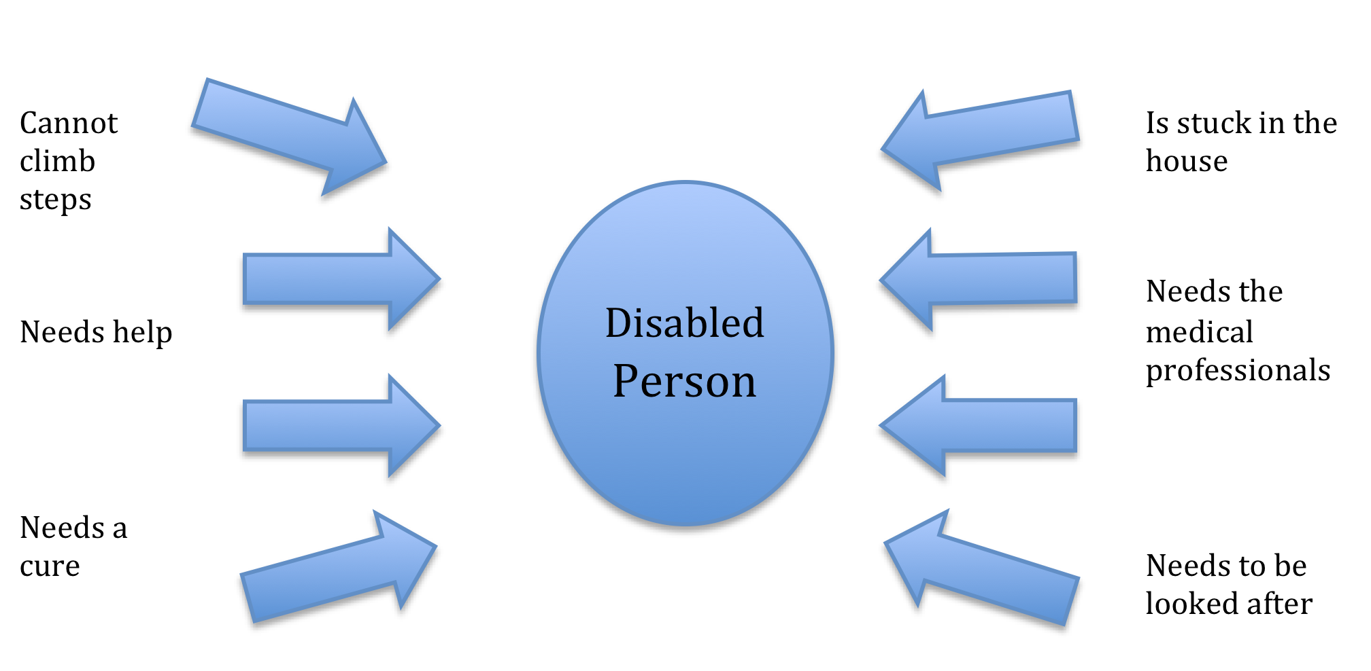
Medical Model of Disability

Slide 18
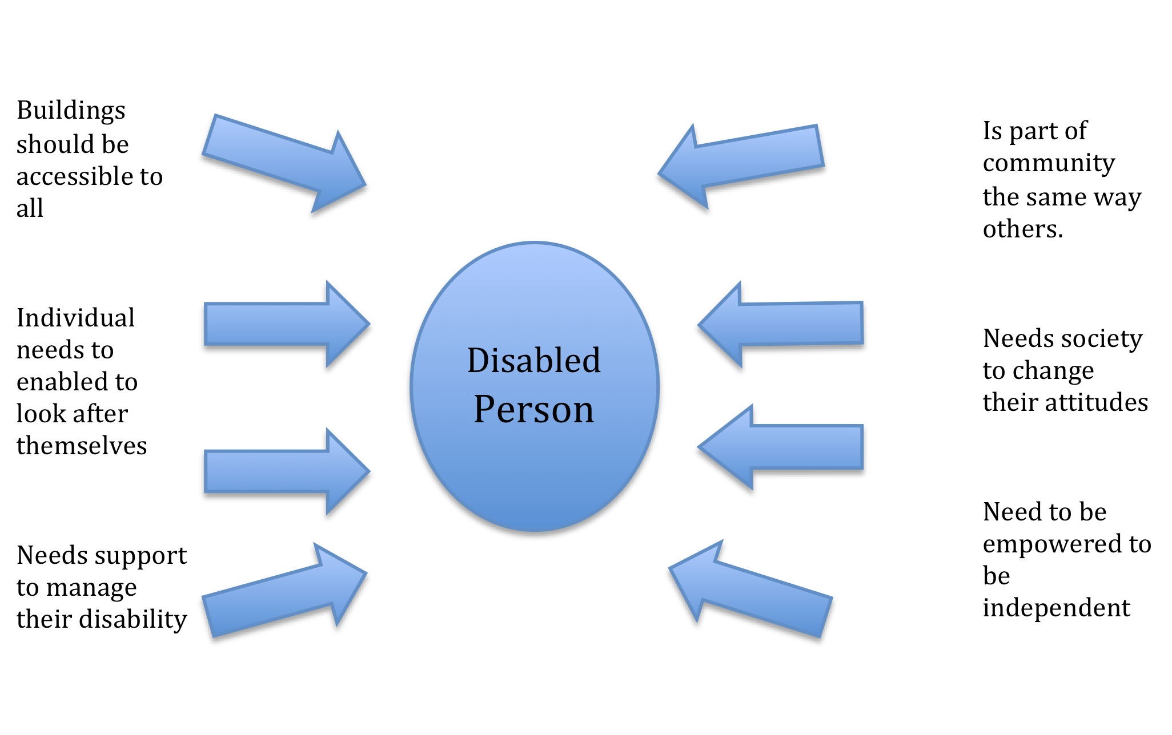
Social Model of disability

Slide 19
Supporting and respecting diversity, different values and cultures.
By ‘culture’ we mean those values, beliefs, attitudes and ways of doing things that are so much a part of us and shape who we are that we take them for granted. Knowing about your own culture and its impact is a useful way to start to understand about other cultures and their importance in people’s lives.

Slide 20
Discrimination often occurs on the grounds of:
Age
Ethnic Origin
Language
Mental health
Gender
Sexuality
Class
Religion
Beliefs
Disability

Slide 21
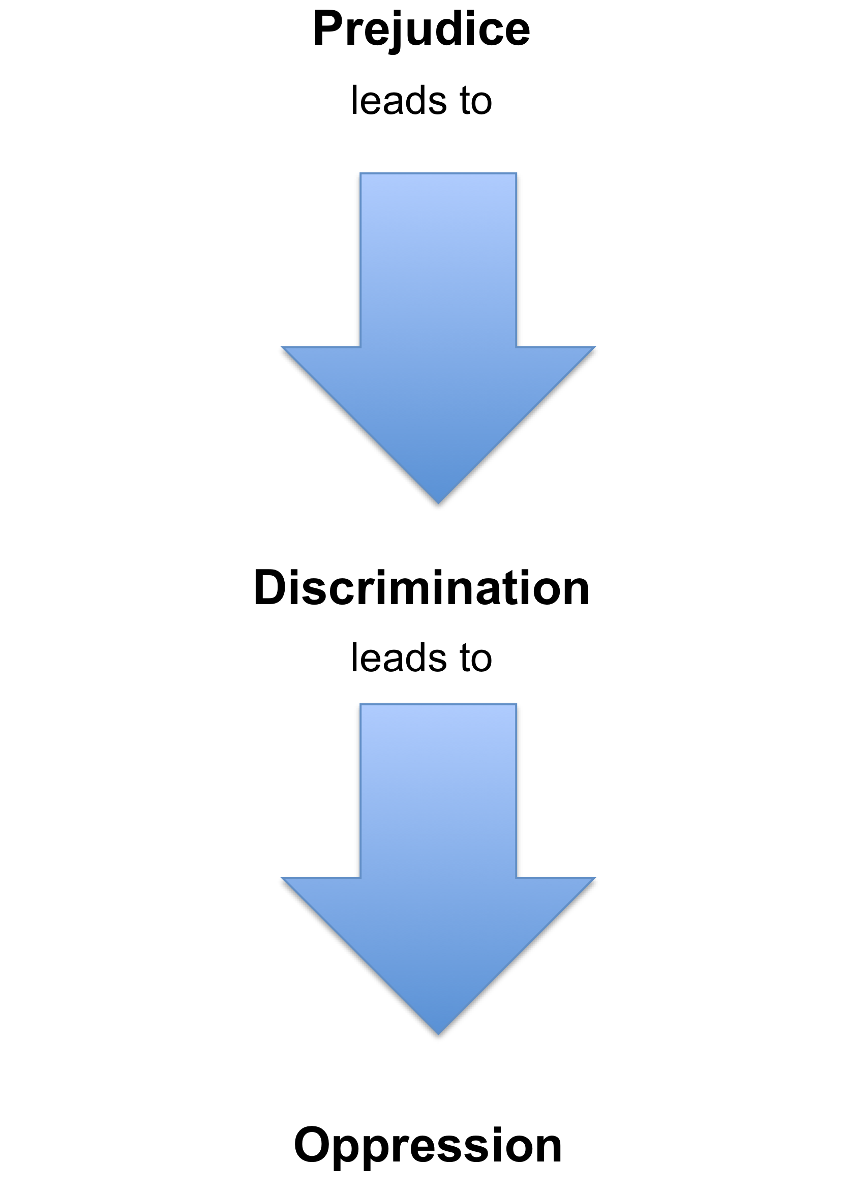
What do we mean by prejudice, discrimination and oppression?

Slide 22
How can you be sure you need to know something?
When you have been told it?
But …
When you have been told it, perhaps then you will decide that you didn't need know it in the first place! Now it is too late because you already know!

Slide 23
‘Ways of Working’ or ‘Policies and Procedures’ with confidentiality
Not having clear policies and procedures can only be harmful to the individuals that you are working with either by not keeping things confidential or by not ensuring the right people are told what they need to know in order to act effectively.
There may be occasions when you feel that the ways of working are not ensuring the safety of the individuals or staff that you work with.

Slide 24
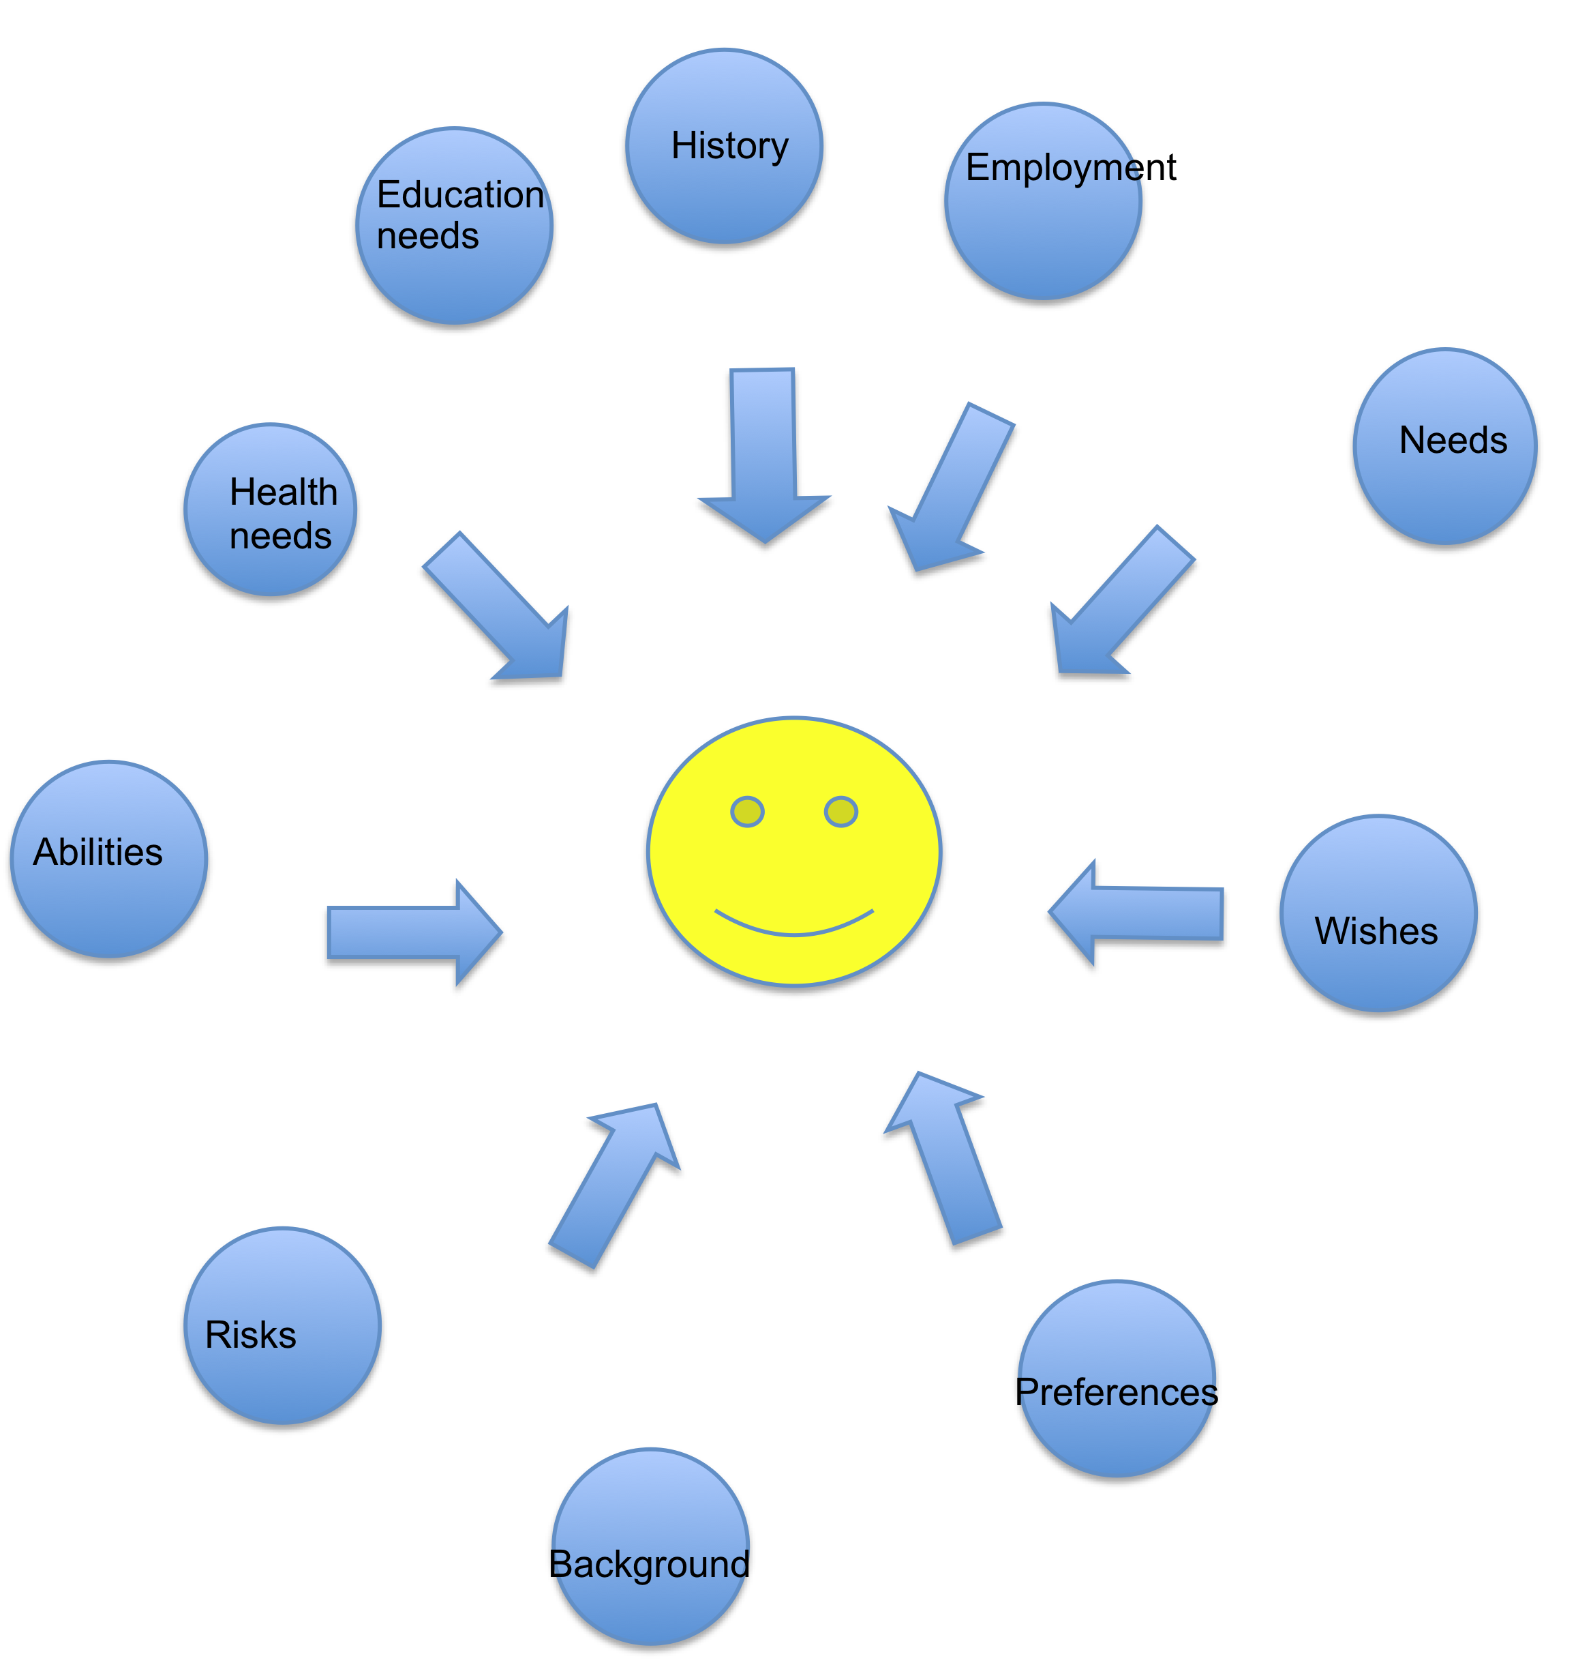

Slide 25
A good person-centred plan includes:
Health needs
Educational needs
Employment options
Social needs
Housing needs
Religious needs and matters
Political views
Cultural needs and matters
For a person-centred plan to work it needs to be a ‘living and breathing’ document, in other words you cannot just write it one day and think it is done.

Slide 26
Five steps to Person-Centred Planning:
1.
The person is at the centre – person-centred planning is rooted in the principles of rights, independence and choice. It requires careful listening to the individual and results in informed choice about how an individual wants to live and what support/ care best suit the individual.

Slide 27
Five steps to Person-Centred Planning:
2.
Family members and friends are full partners – person-centred planning puts the individual in the context of their family and communities. The contributions that friends and families can make are recognised and valued and gives a forum for creatively negotiating conflicts about what is safe, possible or desirable to improve a individual’s life.

Slide 28
Five steps to Person-Centred Planning:
3.
Person-centred planning reflects an individual’s capacities – what is important to the individual (now and for the future) and specifies the support they require to make a valued contribution to their community. Services are delivered in the context of the life an individual chooses and not about slotting them into ‘gaps’

Slide 29
Five steps to Person-Centred Planning:
4.
Person-centred planning builds a shared commitment to action that recognises an individual’s rights. It is an ongoing process of working together to make changes that the individual and those close to them agree will improve their quality of life.

Slide 30
Five steps to Person-Centred Planning:
5.
Person-centred planning leads to continual listening, learning and action and helps the individual get what they want out of life. Learning from planning can not only inform individuals but can affect service delivery as a whole and inform and inspire others to achieve greater things.

Slide 31
Schalock (1990), one of the key researchers in the field of quality of life for people with disabilities, defines quality of life as:
‘The outcome of individuals meeting basic needs and fulfilling basic responsibilities in community settings (family recreational, school and work). Individuals who are able to meet needs and fulfil responsibilities in ways satisfactory to themselves and to significant others in community settings experience a high quality of life in those settings’.

Slide 32
Quality of life is:
composed of those same factors and relationships for people with disabilities that are important to those without disabilities
experienced when a person’s needs and wants are met and when one has the opportunity to pursue life enrichment in major life setting
both subjective and objective components, but is primarily the perception of the individual that reflects the quality of life he/she experiences

Slide 33
Quality of life is:
based on individual needs, choices and control
a multidimensional construct influenced by personal and environmental factors, such as: intimate relationships, family life, friendships, work, neighbourhood, city or town of residence, housing, education, health, standard of living and the state of one’s nation

Slide 34
The eight core domains of the quality of life:
Physical well-being
Emotional well-being
Interpersonal relations
Material well-being
Personal development
Self-determination
Social inclusion
Rights

Slide 35
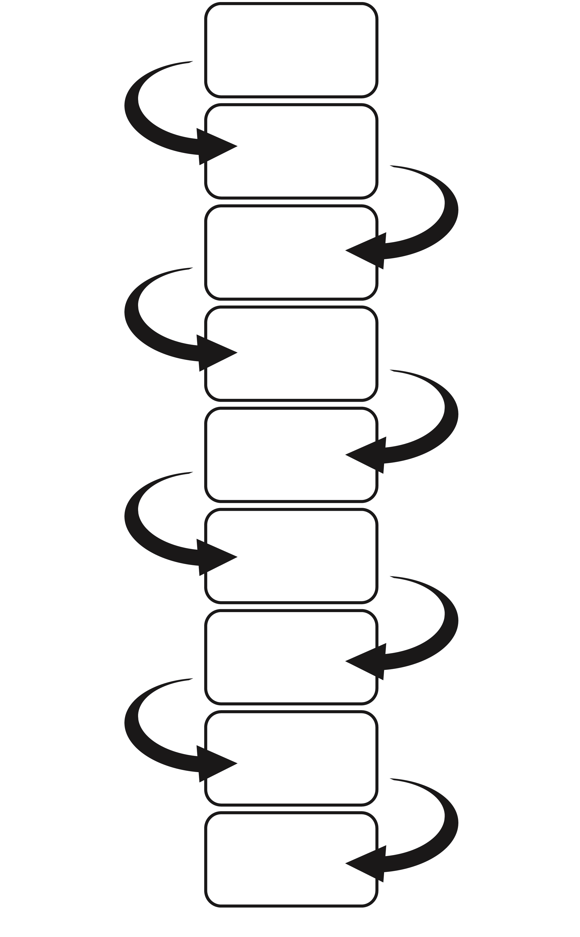
Not having any choices
Poor self image
Low self esteem
Lack in confidence
Unable to make choices
Poorer
self –image
Lower self esteem
No confidence
Cannot make any choices takes a passive role
Disempowered

Slide 36
Duty of Care
When you are supporting or caring for individuals, you have a duty to ensure that they do not put themselves in danger, put others in danger or you in danger.
Our ‘duty of care’ enables us to think about the safety of those who we work with.
Our responsibilities mean we must consider the impact of our actions or even lack of actions on each individual we are working with.

Slide 37
To maintain duty of care we should:
Keep your knowledge and skills up-to-date
Provide service at a standard that any reasonable person would expect
Know what you should do to ensure that the service that you provide is provided safely
Keep accurate records as required by your employer
Only delegate work or accept it when it is safe to do so
Protect confidential information except where it conflicts with public interest or safety.

Slide 38
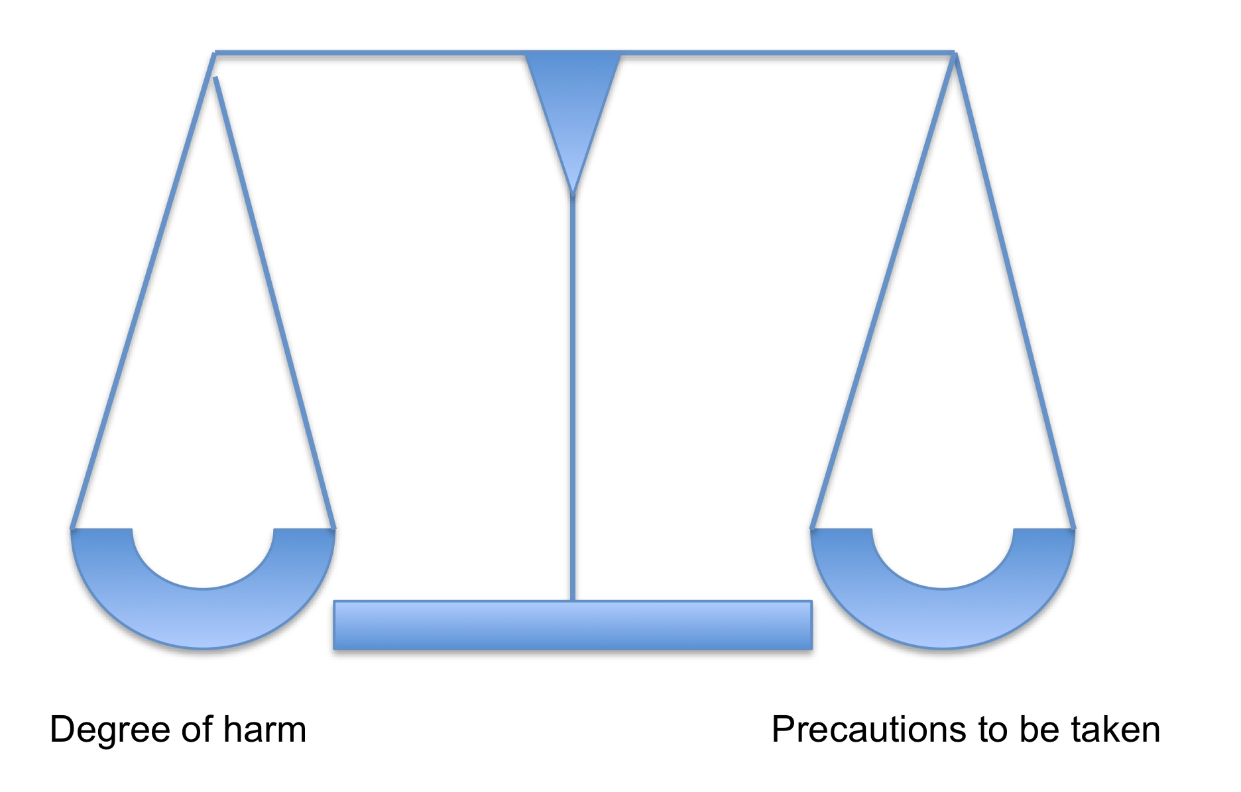
Risk Assessment
When you do a risk assessment you look at all of the hazards (all of the things that may cause harm), then you work out how bad they are and then look at ways of making them not as bad.

Slide 39
Risk Assessment
How serious is the possible harm?
For example, on crossing a road there is a possibility of being hit y a car. The possible harm from this is serious, therefore, the risk is high.
How likely?
Here you think about how likely it is that the harm may occur. In crossing the road, for example, the likelihood is going to be high if the road is a busy one: if it is a quiet country road the likelihood is going to be lower.

Slide 40
Risk Assessment
Can I reduce either of these?
If both the risk and likelihood are high then it may not be worth taking the risk, unless you can look at ways to reduce either of these. Returning again to the example of the road, you can reduce the risk of being hit by a car by ensuring you use a zebra or pelican crossing. The greater the harm and the greater the likelihood, the greater precautions are needed.
Is it still worth taking the risk?
Once you have looked at the seriousness and likelihood of harm, the precautions you can take and the benefits of taking the risk, you need to decide whether the risk, even with the precautions in place, is still too high to take.

Slide 41
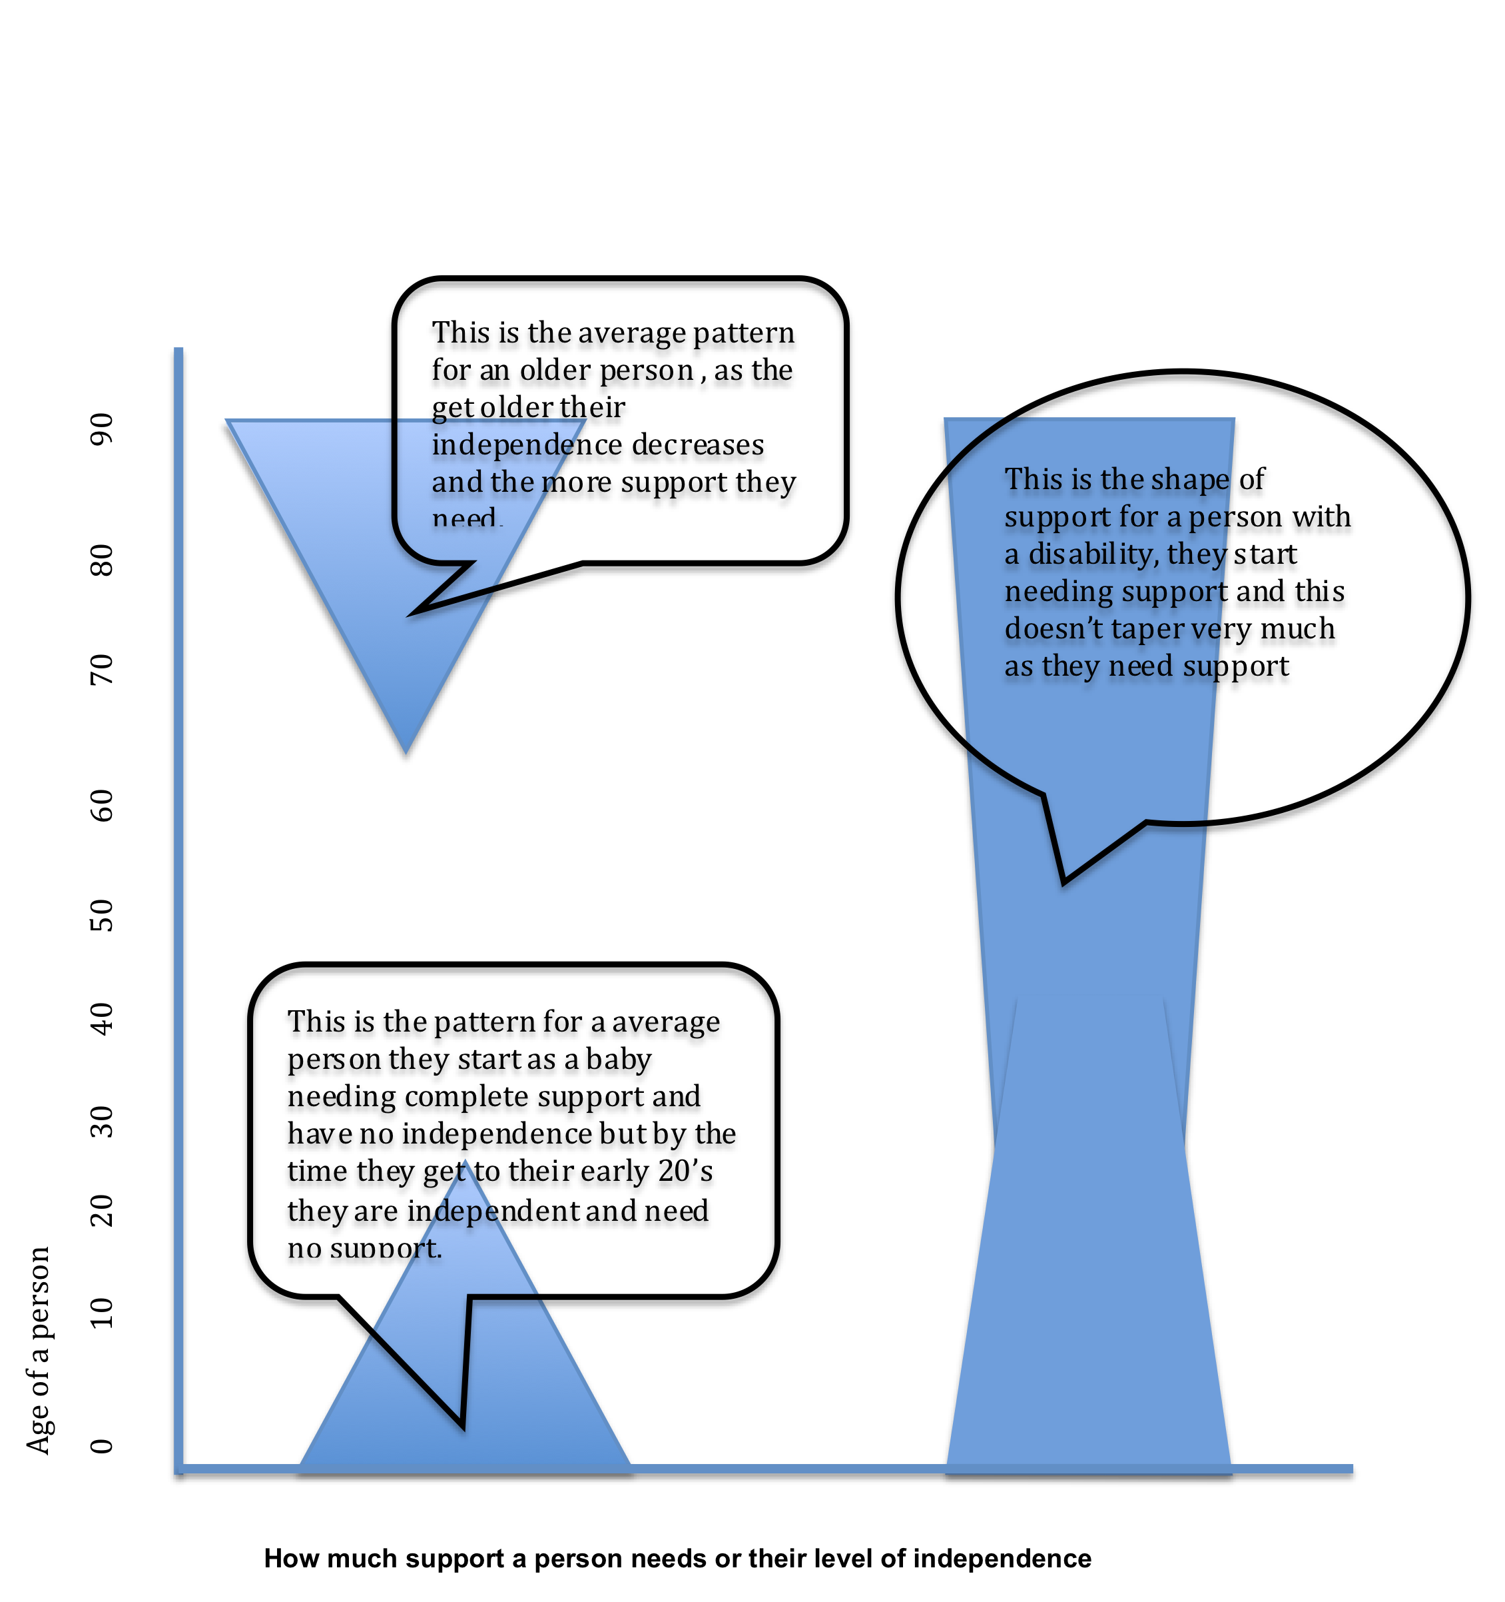

Slide 42
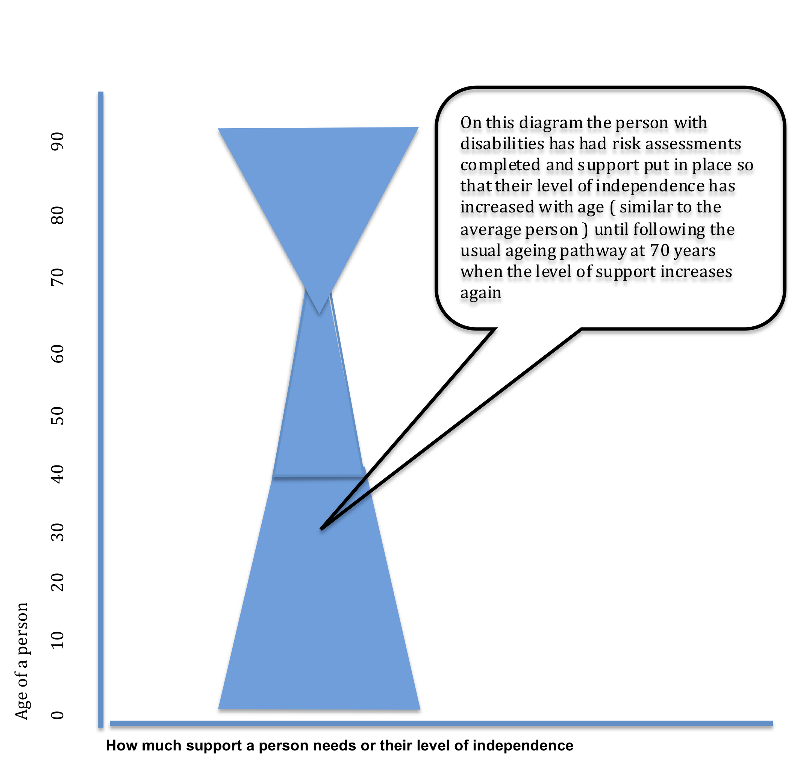

Slide 43
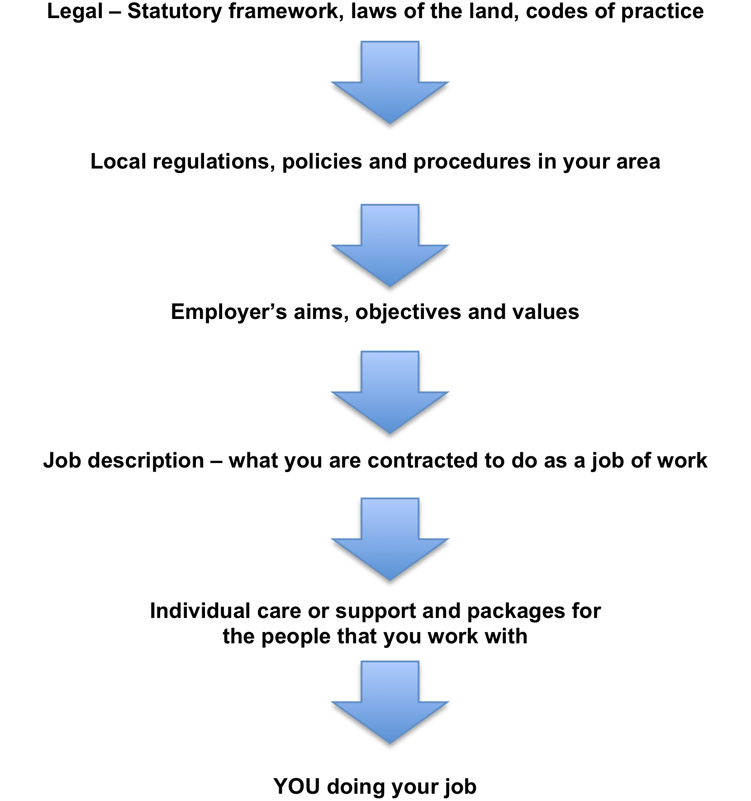

Slide 44
How you see the individuals you work with:
It is about ensuring that you see the individual who you work with in a broad context which includes:
Their history and previous life
Their achievements
Their abilities
The family background
Their ethnicity and gender
The nature of their problems or disabilities
The discrimination they may face
We want to make you think about the nature of the relationships you have with the individuals that you are working with. A relationship does not have to be complicated; it is simply what goes on between two people and can take many different forms. During the course of our lives we have many different relationships and some are more permanent or important to us than others.

Slide 45
When working with fellow professionals you must:
Observe professional boundaries (do not try to do someone else’s job!)
Share information on a ‘need to know’ basis
Do not let how you feel about the professional affect your relationship with them
Don’t collude to exclude the individual/s you are supporting
It is vital for you to think about the role of families, friends and advocates in relation to the lives of the individuals you are working with.
Even if you are working with individuals who have little or no contact with families, the notion of family and friendship is still important. You might find yourself trying to promote contact with families and friends for the sake of the individual you support, as they want to re-establish contact. Or you might find yourself having to work with the fact that an individual feels animosity towards, or feels abandoned by and at a loss in relation to their particular families.

Slide 46




Substances that are hazardous to health
Thousands of people are exposed to all kinds of hazardous substances at work. These can include chemicals that people make or work with directly, and also dust, fumes and bacteria, which can be present in the workplace. Exposure can happen by breathing them in, contact with the skin, splashing them into the eyes or swallowing them.
If exposure is not prevented or properly controlled, it can cause serious illness, including cancer, asthma and dermatitis, and sometimes even death. There are many substances, which we all have in our homes that could, if not handled safely, cause a serious hazard.

Slide 47
Moving and Handling
3 basic steps to follow at all times when you are considering moving and handling tasks.
Where possible avoid the task
Assess the risks
Reduce the risks

Slide 48
Moving and Handling
Where ever possible moving and handling should be avoided however when it must take place measures should be put in place to:
Assess the potential dangers
Reduce those dangers where possible
If you cannot reduce them you should not complete the task.
This is when a ‘risk assessment’ would take place.

Slide 49
Fire Safety
You should know where the following are in your workplace:
Fire alarm system
Emergency lighting
Fire doors
Fire exits
Fire fighting equipment

Slide 50
Fire Safety
1. How to recognize a fire, if and when to tackle it and with what.
2. How to raise the alarm on discovering a fire in different areas of the workplace, e.g. shout ‘fire’, use a whistle, activate alarm point, telephoning the fire brigade.
3. How to get your self and others out of danger, e.g. evacuation techniques, phased evacuation, safe areas, exits, escape routes, rendezvous point.

Slide 51
Fire Safety
4. What to do at the meeting point.
5. What to do after a fire.
6. Not to use a lift/elevator
7. Do not block or lock or prop open fire doors or fire exits

Slide 52
Fire Safety
At worst fire can kill and it can do so quickly, silently and without warning. For these very reasons you need to understand how fires are most likely to start in your work place, what you can do to prevent it and do if you ever encounter it.
Fire requires 3 things to survive and spread:
Heat
Fuel
Oxygen

Slide 53
Fire Safety
Fire sources- Common sources of fire are:
Electrical faults e.g. faulty wiring on electrical appliances or sockets
Cooking e.g. people leaving fat or oil or other flammable liquids on an open flame
Smoking e.g. cigarette stubs, hot ash or matches falling onto bedding, sofas, clothing or carpets
Chemicals e.g. storing paint cans, oily rags, petrol or other flammable liquids in a closed environment where they may overheat or catch a spark
Candles especially if left unattended

Slide 54
Fire safety
There are some routine checks that should take place last thing at night or before leaving a building for any length of time. These are:
The cooker is turned off
Nothing has been put on the cooker
Electrical appliances are off and un plugged
Heaters are off
Fire guards are in place
Ash trays are empty
Smoke alarms are in place and batteries have been checked
Candles have been correctly extinguished

Slide 55
Basic First Aid
What to do if an individual is unconscious?
What to do if someone is not breathing?
How to contact the emergency services?
How you can put someone into the recovery position
What to do if an individual is bleeding?
What to do if an individual is choking?
What to do if an individual has a seizure?

Slide 56
Infection Control
Infections are spread by micro organisms which are found in the air, on skin, in food and on everything that we touch. Some micro organisms are harmless these are called non-pathogenic, the ones that are harmful are called pathogenic.

Slide 57
Infection Control
These pathogens spread through:
Open wounds
Inhalation (Breathing in)
Injection
Ingestion (Swallowing)
Infection can enter the body through broken or damaged skin, membranes in the eyes, nose and air passages, through eating contaminated food or drink, sexually transmitted.

Slide 58
Infection Control
You should wash your hands:
At the start and end of each shift
Before and after supporting an individual (even if wearing sterile gloves)
Between contacts with different individuals
After using the toilet or supporting toilet activity
After coughing, sneezing or blowing nose
Before and after eating, drinking and handling food
Whenever visibly dirty

Slide 59
Infection Control
Good hand washing technique:
Wet hands thoroughly under running water
Apply hand washing agent( soap, gel, anti bacterial wash)
Distribute thoroughly
Vigorously rub hands together for 10 to 15 seconds, carefully include all fingers, thumbs, backs of hands and wrists.
Thoroughly rinse any soap and debris
Dry hands with warm blow dryer or paper towel ( try to avoid cloth towel as these harbour bacteria and may contaminate your clean hands

Slide 60
Infection Control
Keep the rest of you clean, maintaining good hygiene standards by:
Showering or bathing daily
Keeping hair clean, keep long hair tied back
Keep nails clean and trimmed
Wear clean clothing
Keep jewellery to a minimum
If you wear a uniform, ensure it is clean at all times

Slide 61
Security
Maintaining security in the workplace can be done through:
Having burglar alarm
Window locks
Secondary locks on doors or windows
Separate reception area with secure door (enabling identity checks)
Door chain
Secure code entry or camera to building
Security lighting
Ways of working for checking Identity of visitors
Clear procedures for securing building at night, when leaving and when in the building

Slide 62
Missing Person
Check that arrangements to go have not been made
Speak to everyone present, gathering information about the circumstances around the person going missing
Tell your line manager
Check day book, visitors book, appointments etc so you are sure nothing has been overlooked
Check there is not just a delay in returning from a visits or appointment
Check there has not been a vehicle break down
Check for messages
Ensure all the building is searched
Search the premises and grounds

Slide 63
Personal Safety and Wellbeing
There may be situations in your job role that your personal safety is under threat.
This could be because:
You are a lone worker
You have to handle valuables (visiting the bank depositing or collecting money)
You could have an accident or injury
You may be at risk of infection
Working with individuals who may have challenging behaviour
You need to be aware of these risks and ensure that you take precautions to ensure that you are not harmed in any of these situations.

Slide 64
Communicating Positively
The communications can be with a wide range of people:
Partner
Child
Friend
Family member
Colleague
Manager
Professional
Neighbour
Service provider i.e. bus driver, postman, shop keeper etc

Slide 65
Communicating Positively
Types of communication can be:
A wave
A conversation
Just one word
A kiss
A brief chat
A request
A nod
A transaction i.e in a shop
The list is endless

Slide 66
Communicating Positively
Motivators for communication are:
a need
a desire/want
a social interaction
stating something
making a choice
expressing a feeling
expressing an idea

Slide 67
Barriers to communication
There are a range of barriers to communication these can be physical barriers such as:
The individual is in pain
The environment is uncomfortable e.g. too hot or too cold
It is too noisy
There are many distractions
The individual cannot hear

Slide 68
Speech Barriers
The message is not adapted for the individual e.g. language is to complex
The use of jargon
The speech is in another language
The person speaking speaks too fast
The person has a strong accent or dialect
The person finds communication difficult

Slide 69
Psychological barriers
The message is too painful to hear
The person does not want to listed
The person giving the message is unclear
It may be too difficult for the person to respond due to pain, discomfort, communication difficulties
The person giving or receiving the message has developed barriers to communication based on prejudice and discrimination
Understanding the barriers to communication will ensure that you can break down those barriers to be confident that you can communicate and interact clearly with everyone.

Slide 70
Active Listening
This a structured way of listening and responding to others it focuses the attention on the person speaking.
You stop your own thoughts judgment so that you listen fully to the speaker

Slide 71
Active Listening Principles
Taking time and space to listen to the person, stop doing other things
Concentrate on the conversation avoid all distractions
Imagine your self in the world of the person
Look at the facts , think about the emotion of what is being said

Slide 72
Active Listening principles
Show that you are interested in a non verbal way; through eye contact, nodding etc
Let the person finish, don't jump in to fill any silences
Don't interrupt
Try to delay your own reaction, don't start to think about what you will say next
Ask questions, encourage the person to explain in more detail
Summarise what the person has said in your own word to check your understanding.

Slide 73
Assisting Active Listening
Using exploratory questions such as ‘what do you mean?”, “can you explain?”
Rephrasing e.g. “have I understood that correctly?”, “Do you mean …?”
Reflecting back to the person e.g. “You are glad the meeting finished then?”
Interjecting: e.g. nodding, smiling, say “yes” or “no”

Slide 74
Barriers to Active Listening
Thinking that you know what the person is going to say before they have said it
Twisting what they are saying to meet with what you want
Making a judgment about the individual whilst they are communicating, affects how well you listen and interpret the message
Being influenced by your own emotions, , sometimes you an misunderstand what is being said because you are already upset or angry and this affects your listening skills.

Slide 75
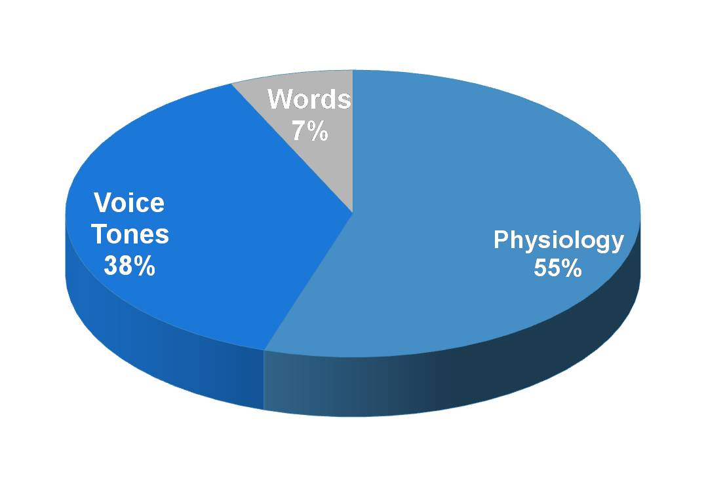

Slide 76
Verbal and non verbal communication
Verbal communication, is when we use words to express our needs or wants, non verbal communication is when we give messages by how we act, this can be; facial expression and body language etc.
When you are thinking about non-verbal communication you must remember that how non-verbal communication can change dependent on the culture of the individual.

Slide 77
Touch as a form of communication
Touching is probably the most primitive and intimate form of communication. Each culture will have its own social rules around who is able to touch whom and in what sort of relationship this should be.
Touch is one of the five senses, and although all the senses are used in gathering and making sense of information, it is through touch that we establish ourselves, and our relationships with the outside world.

Slide 78
Unacceptable Touch
Sexual touching of any sort is not appropriate for a worker, and will leave your managers no alternative but to instigate disciplinary procedures
Some types of touch are not acceptable in some cultures
Touching that is in any way negative
Some individuals are sensitive to touch

Slide 79
Setting the Boundaries of touch
Whether the individual feels comfortable with touch
Whether there are any cultural taboos or customs relating to touch
What kinds of touch they would find appropriate and acceptable
How you could regularly check out that the touch you and others were using was positive and not negative.

Slide 80
Recording and Reporting
Recording and reporting is an important part of your role. To provide a good service for the individuals whom you are supporting you will need to record and store information about them.
We need to do this because:
We need to be able to ensure that the service and support that we provide is tailored to individual need
To ensure we have a consistent approach
To ensure the individual is safe e.g. recording information about health, medication accidents and illness.

Slide 81
Recording and Reporting
To ensure we keep the individual healthy with appointments for health checks such as doctors, opticians, dentists, etc.
To ensure we area accountable for our practices, recording events, changes and collecting information on a particular difficulty or issue
We need to know what decisions have been made about an individual.

Slide 82
We need to record and report because:
Often our memories are unreliable
We work in a team, no one is around all of the time, there may be staff changes
Things get lost or garbled if messages are passed on
It helps maintain consistency
There are always so many things to remember!

Slide 83
Recording and Reporting
Personal information- here we must resist the temptation to say, ‘I need to know everything about someone so that I can be as well informed as possible.’ Remember we covered this when we discussed confidentiality.
General information- this is usual information that is not seen as appertaining to the individual such as a shopping list, or how to get somewhere.

Slide 84
When recording thinking about:
Would the individual want me to know this?
Is this information going to help me to keep individuals safe?
Will this affect my ability to make a sound judgment?
Will it help me to take action now ort in the future?
Will it enable me to check the outcome from an event or incident?
Will it increase my understanding of what I am doing?
What would happen if I did not know this?

Slide 85
Types of recording and reporting:
Accident or incident book
Diary
Shifts patterns
Visitors
Health records
Person centred care plans
Weight and height charts
Activities books
Fire checks
First aiders and fire
Wardens
Training record
Continence and bowel records

Slide 86
Important factors in report writing:
The information is written clearly and legibly
Language used is jargon free
Information is kept separate to opinion
The report is dated and signed
Confidentiality is considered
Information is stored correctly

Slide 87
When writing reports think:
Why?
Who?
What?
How?
Where?
When?

Slide 88
Recognising and responding to abuse and neglect.
Definition of abuse:
‘Abuse is violation of an individual’s human and civil rights by any other person or persons’

Slide 89
Types of Abuse
Physical
Sexual
Emotional and psychological
Financial
Institutional
Neglect
Medication abuse
Discrimination abuse

Slide 90
Where does abuse happen?
ANYWHERE!

Slide 91
What leads others to abuse?
There are a number of factors which might contribute to a worker abusing someone in their care. These might include:
Unsuitability for the work
Behavior learnt from others
Their own experience as a victim of abuse
Opportunity to exert power over another person
Entrenched or outdated views
Isolation
Insecurity

Slide 92
What leads other to abuse?
Lack of training
Lack of supervision or inappropriate supervision
Ignorance
‘Burn out’ exhaustion from the workload
Poor pay, terms of conditions of employment
Lack of clear policies and procedures
Needs of individuals exceeding abilities of worker
Institutional or authoritarian regime
Mismatch with staff skills and demands of the job and staffing levels.
Lack of staff
Absence of team work

Slide 93
What should you do?
As a worker you have a duty of care both to protect the individuals you work with from harm and to take prompt action if you suspect that a person may be at risk of abuse. What are your responsibilities if you suspect that someone in your care might be experiencing abuse?
The worst thing you can do is nothing!

Slide 94
What should you do?
Act on any suspicions of abuse/neglect
Treat all abuse or potential abuse/neglect seriously
Know the ways of working relating to abuse /neglect
Know what to do if you have a concern or have received a report
Know where to go to get help

Slide 95
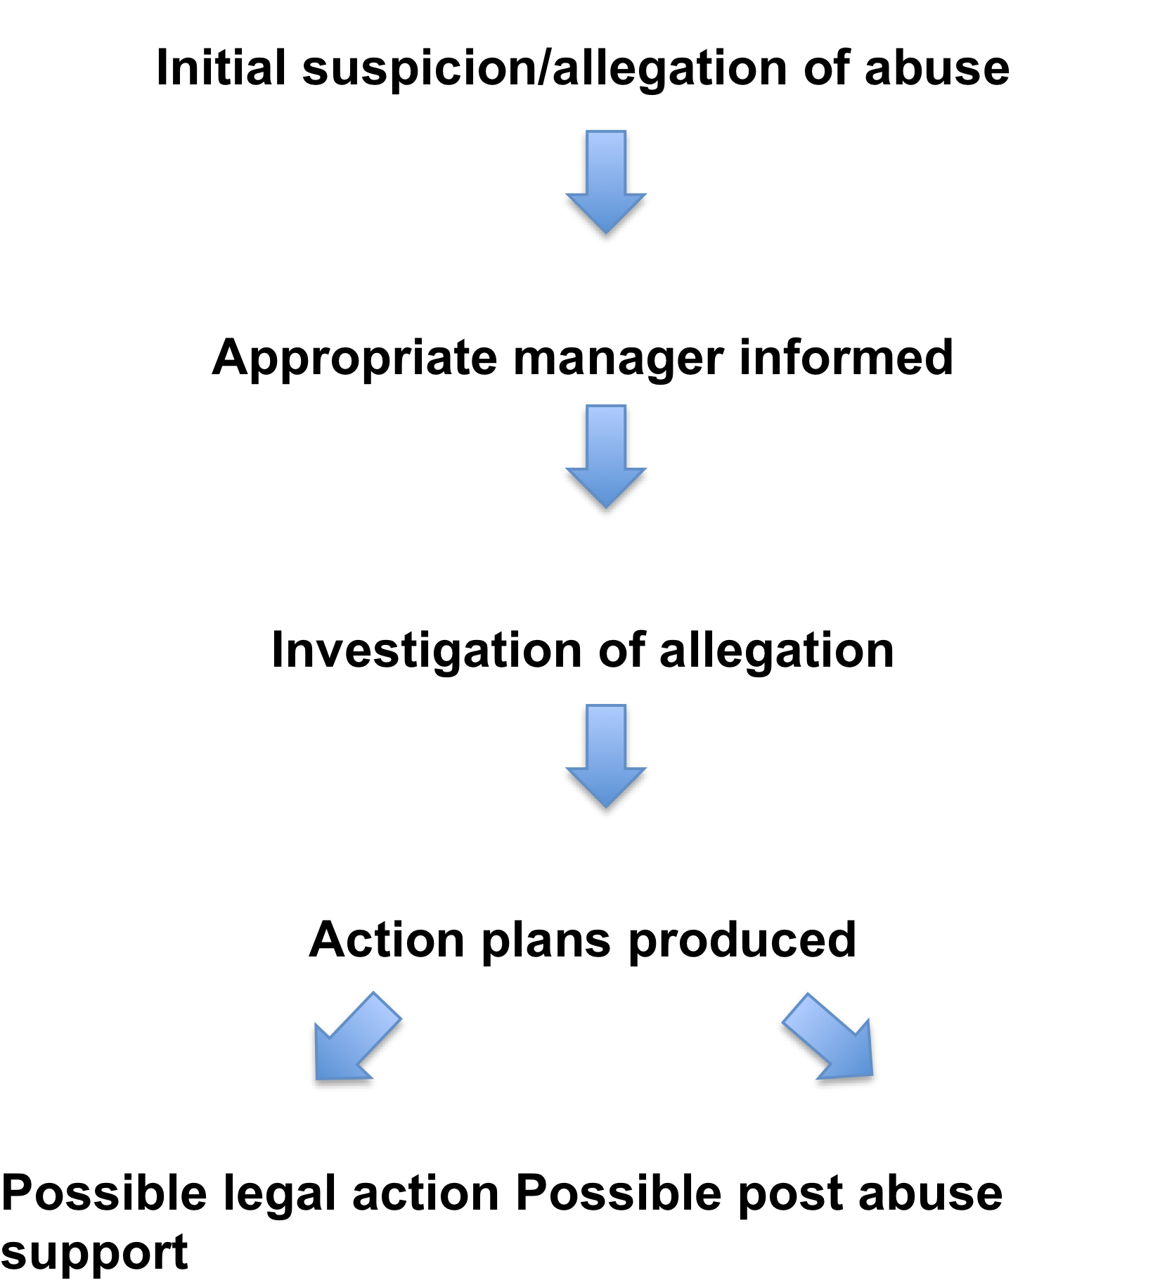
What is likely to a happen?

Slide 96
Legislation and Guidance
The belief that every person has a right to live a life free from abuse and neglect in line with ‘The Human Rights Act, 1998’.
Knowledge that illness, age or disability may severely compromise an individual’s ability to keep safe and that information sharing and multi-agency working raises the likelihood that vulnerable adults will be safeguarded; and
Work within those agencies represented, to prevent abuse/neglect by implementing the Safeguarding Partnership Strategic Plan
Agreement that policies and procedures apply equally across all settings. Abuse can take place in any context. It may occur when a vulnerable adult lives alone or with relatives; it may also occur within nursing, residential or day care settings, in hospitals, custodial situations, support services into individuals’ own homes or in public places. ( Ref: No Secrets)

Slide 97
Policies and procedures or ‘ways of working’ relating to:
Violence and aggression
• Anti-bullying
• Anti-harassment
• Equal opportunities
• Restraint
• Whistle blowing
• Complaints
• Risk management

Slide 98
Other relavant legislation:
Human Rights Act 1997
Mental Capacity Act 2005
Criminal Justice Act 1998
Sexual Offences Act 1997
Equalities Act 2010
Public Interest Disclosure Act (PIDA) 1998
Health and Social Care Act 2008

Slide 99
Care Quality Commission
There are 6 outcome areas set out by CQC that those who provide care must adhere to:
Information and involvement
Personalised care, treatment and support
Safeguarding and safety
Suitability of staffing
Quality and management
Suitability of management

Slide 100
CQC says:
‘It is important to recognize that effective safeguarding requires compliance with a whole range of registration requirements –not just the regulation that explicitly covers safeguarding for example; effective safeguarding requires robust recruitment and vetting procedures for staff, enough well trained and competent staff, effective and appropriate treatment and systems that allow people who sue services and their representatives to feedback concerns’.

Slide 101
Supervision
A chance to share any problem areas of work
The opportunity to benefit from other’s experience and expertise
Time to give you feedback on your practice
To share successes you have had the expertise you are developing
The opportunity to plan your work and to identify any areas where you may be overloaded or under utilsed
The opportunity to discuss areas of training need or for personal development

Slide 102
Negative Stress
Demands- the feeling that demands are too high, this could be workload, study, living or work patterns or environment
Control- how much say a person has in the way they live or work and make choices in their live
Support-lack of support and encouragement from other staff or managers
Relationships- this can be personal or with colleagues and managers, it can bring about unacceptable behavior at work or home
Role- lack of clarity in an individuals role

Slide 103
Symptoms of negative stress
Fatigue
Restlessness
Slow thinking processes
Edgy or sharp response to simple requests
Lack of sleep
Lack of motivation
Loss of sex drive
Lack of appetite

Slide 104
Reducing negative stress
Find out what the cause is and understand why you are stressed so negatively.
Get support, from colleagues or friends
Talk to someone
Take up some form of relaxation, yoga, massage, aromatherapy, reflexology etc
Develop a plan to tackle to the stress
Change your working patterns to reduce the cause of the stress
Take up an activity that helps you release stresses such as a sport e.g. running, swimming, cycling, racquet sport
Take up a relaxing hobby such as singing, dancing, painting etc.

Slide 105
Avoiding negative stress
Don't expect too much from yourself
It should be part of your team ethos that you look out for each other with regard to stress
Learn to say no and don't be afraid to do this
If negative stress continues you may need to visit a doctor or specialist for advice, support and/or treatment.
Don’t just accept it, do something!
Remember you would follow these same processes if you were supporting an individual who was experiencing negative stress.

Slide 106
Thank you
For more information you can contact:
www.arcuk.org.uk
Telephone 01246 555043
Shirley.potter@arcuk.org.uk

